Slide 1
Hello Dr. Kabbani,
Here are some of the shapes we have been considering for the heat transfer between the ice and air in our refrigerator for passive cooling mode.
We are leaning towards something similar to option 2.
Please note that these drawings are not very detailed or precise, they are just to convey a general shape/idea. The gaps where air can flow without passing through fins must be removed.
We are making decisions on which design to move forward with this week. Any feedback or suggestions on alternative shapes would be greatly appreciated!

Slide 2
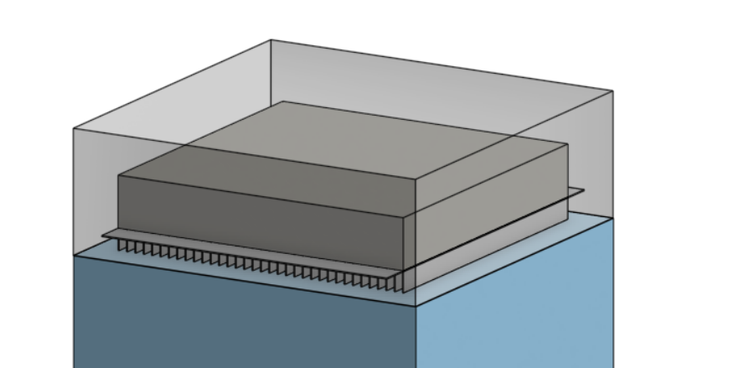
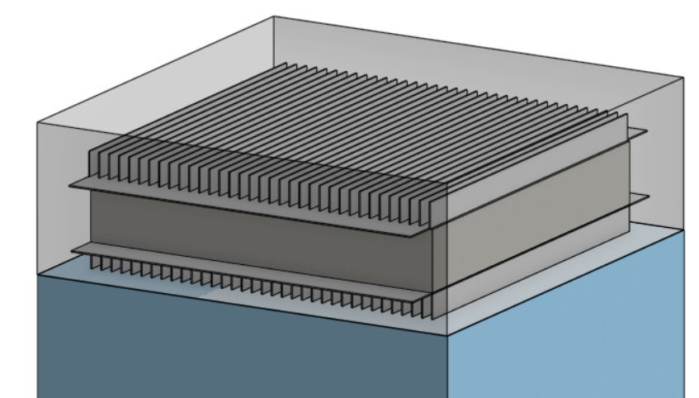
Option 1: Having a single block of ice with fins on top of the refrigerator
1a
1b
This is the simplest design
Fins could be located just on bottom or top and bottom for more surface area.
Airflow would be confined to pass through the fins (The gap between the fins/top of the ice block and the shell would be removed)

Slide 3
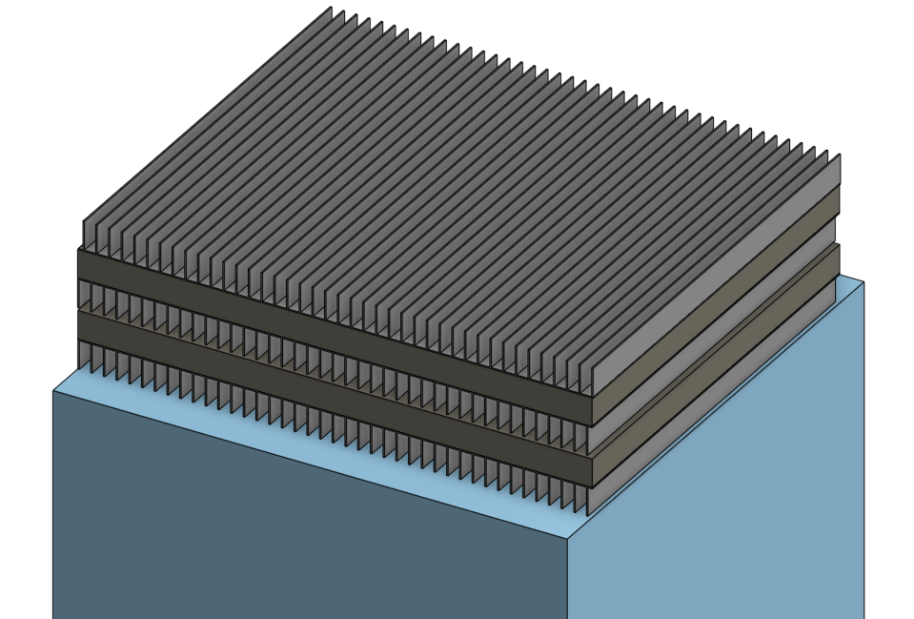
Option 2: Multiple layers of ice with fins in between on top of refrigerator
Thinner layers to further increase the surface area with fins.
Would look into how to optimize the thickness of the ice layers and how tall the fins should be for maximum heat transfer
The quantity of sheets would also depend on our estimated load
2

Slide 4
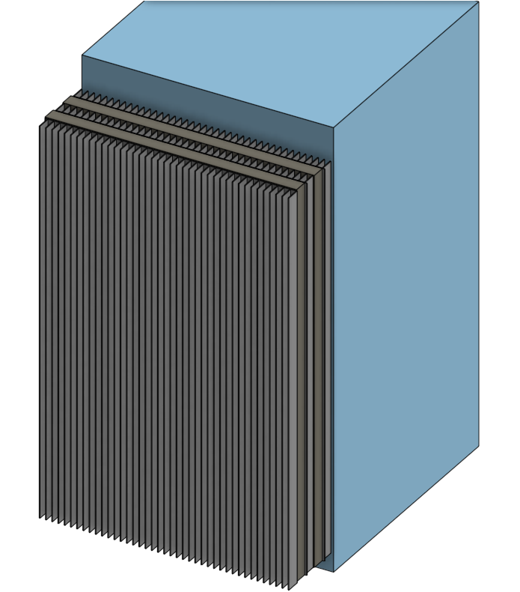
Option 3: Multiple layers of ice with fins vertically on back of refrigerator
Provides a lot of surface area
Downside is that ice freezes slower when it is vertical - may require more energy to freeze

Slide 5
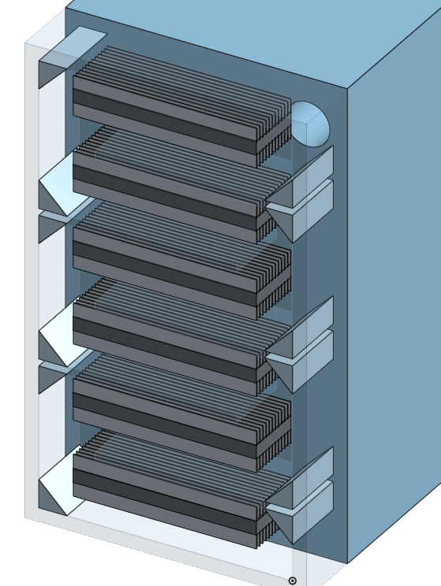
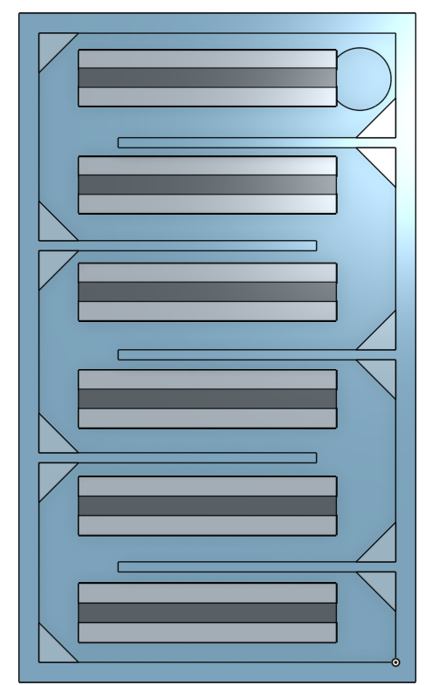
Option 4: Directing air through serpentine pattern with horizontal ice packs + fins
Air snakes through a chanel
Can round the corners or add wedges to decrease pressure drop in the corners
Would likely want less turns than pictured. The more turns the more pressure loss and a larger fan will be required.
Note that the extra space between the top/bottom of the fins and the platforms must be removed.
Can add multiple layers of ice per each turn
Allows for use of horizontal ice packs while using the vertical space behind the refrigerator

Slide 6
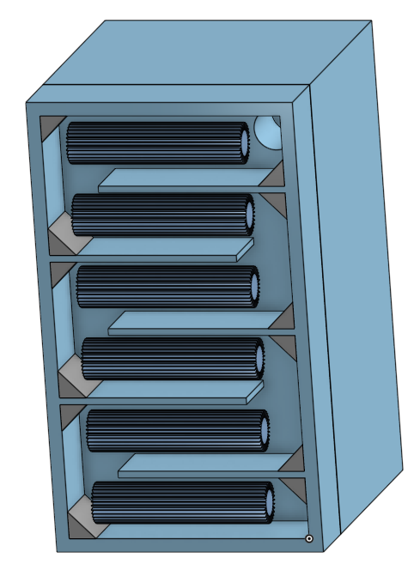
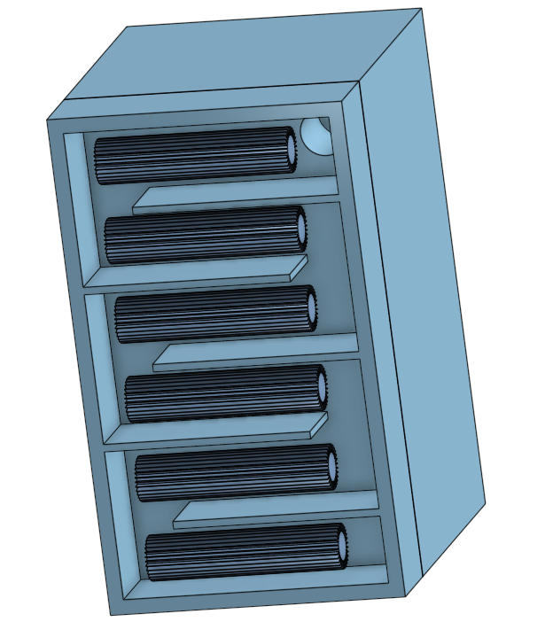
Option 5: Serpentine pattern with circular ice packs + fins
The circular tube shape for the ice is not practical. It would be more difficult to manufacture and would have less surface area than a square/rectangle
The unused area around the fins must be decreased.

Slide 7
